Slide 1
May the job be with you.
Overview of the workforce labour in New Brunswick.

Slide 2
Summary
Unequal distribution
Unbalanced sector
Perspectives on the future.
Notes:
Problem : Across N.B, theme are unequal investiment across industry.
Why it matters : aging workforce, High unemployment ; Indistry inbalance.

Slide 3
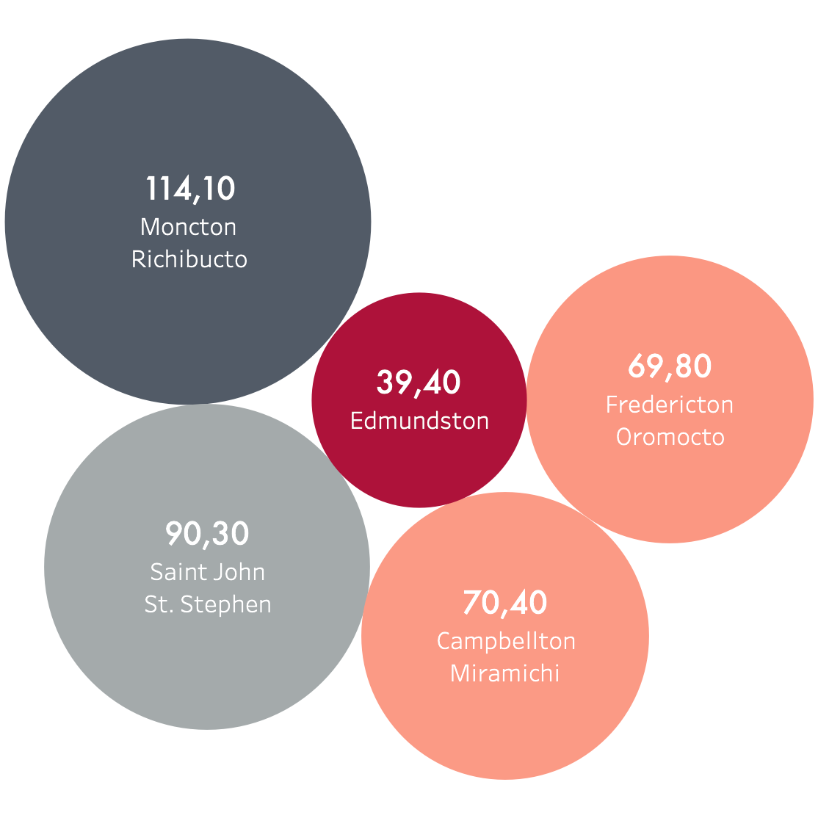
Unequal distribution

Slide 4
Unemployment rate

Slide 5
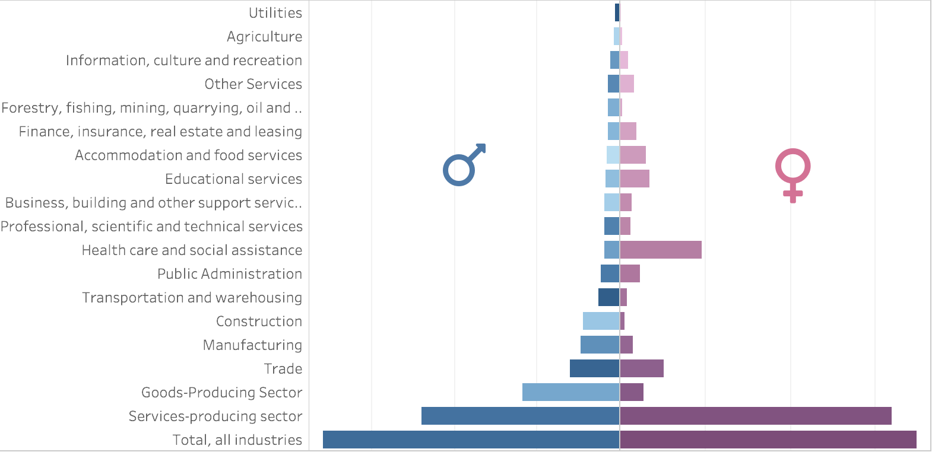
Distribution per gender
Notes:
3 sectors for Men (Goods Producing ; Trade Sector)
Women (HealthCare + social assistance ; Educational Services ; Accomodation and food services);

Slide 6


Distribution per gender
Sectors dominated by
Sectors dominated by
80%
Goods producing sector
*agriculture, forestry, mining, fishing, construction and manufacturing
57%
Services producing
*noncommercial activities, such as health and welfare, education, religion and charity

Slide 7
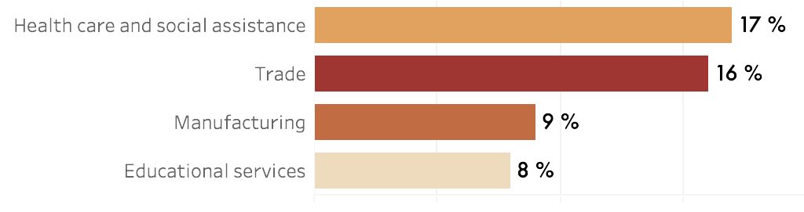
Distribution per sector
Notes:
Clear this : HealthCare industry ; Trade ; Manufacturing ;

Slide 8
Distribution

Slide 9
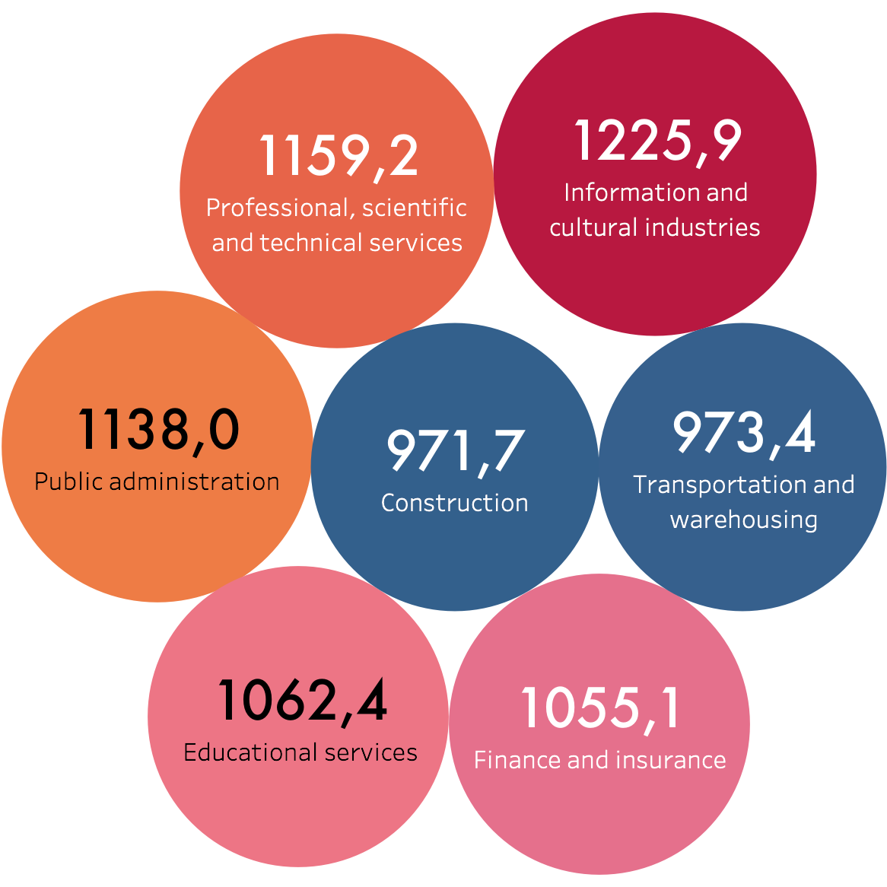
Earnings
Gini Coefficient
Notes:
Non necessary;

Slide 10
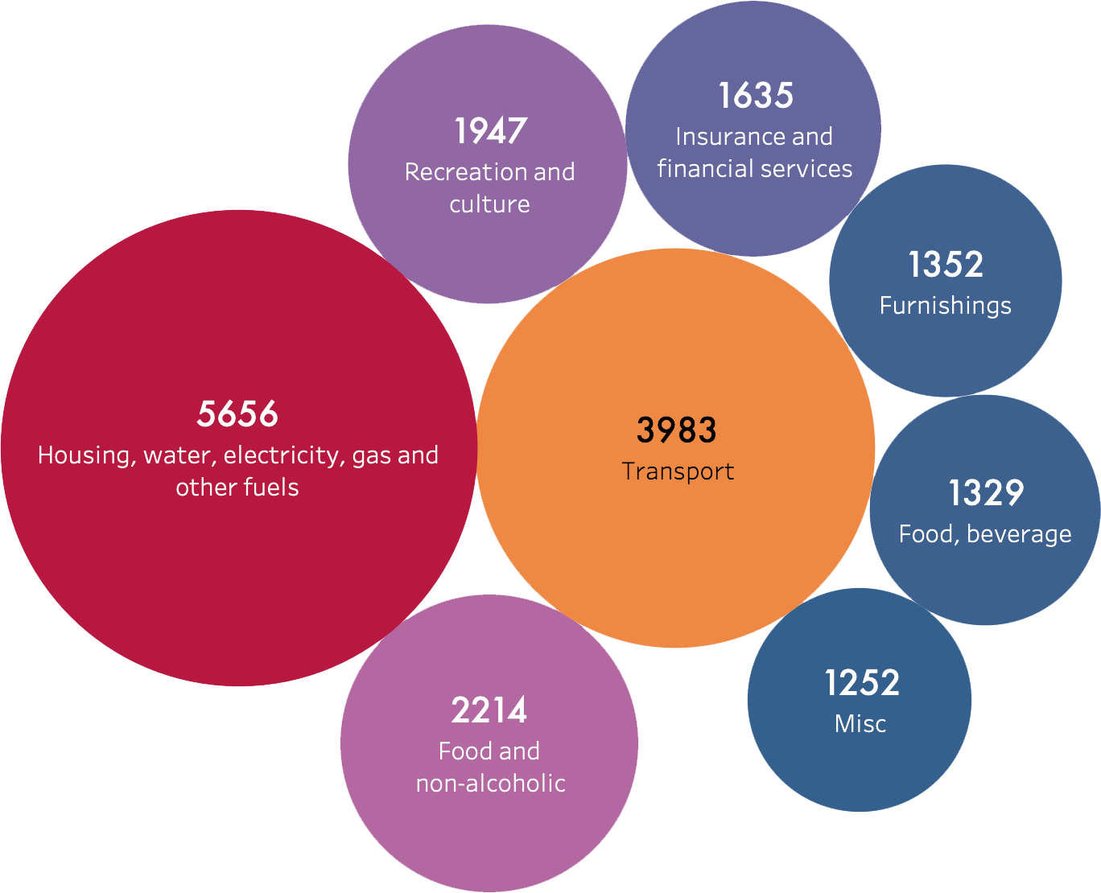



Spendings
for every 100$ :
24.20$
17.04
9.47 $
*Average of 23 784 $ per family

Slide 11
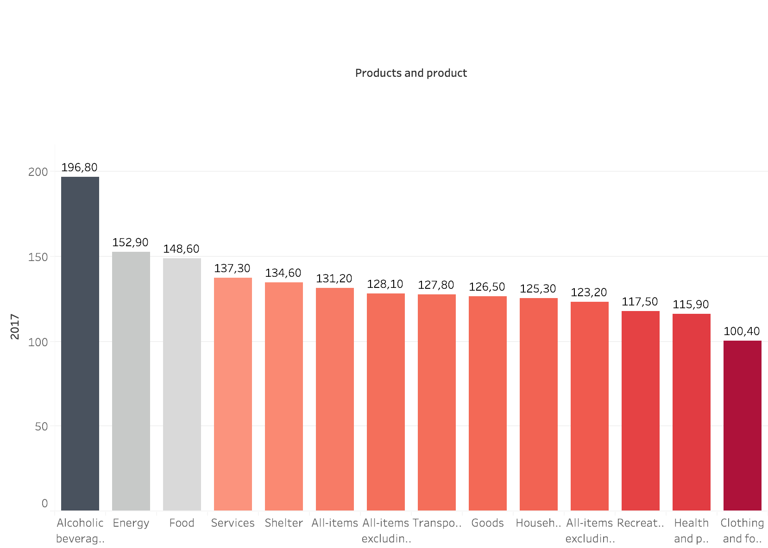
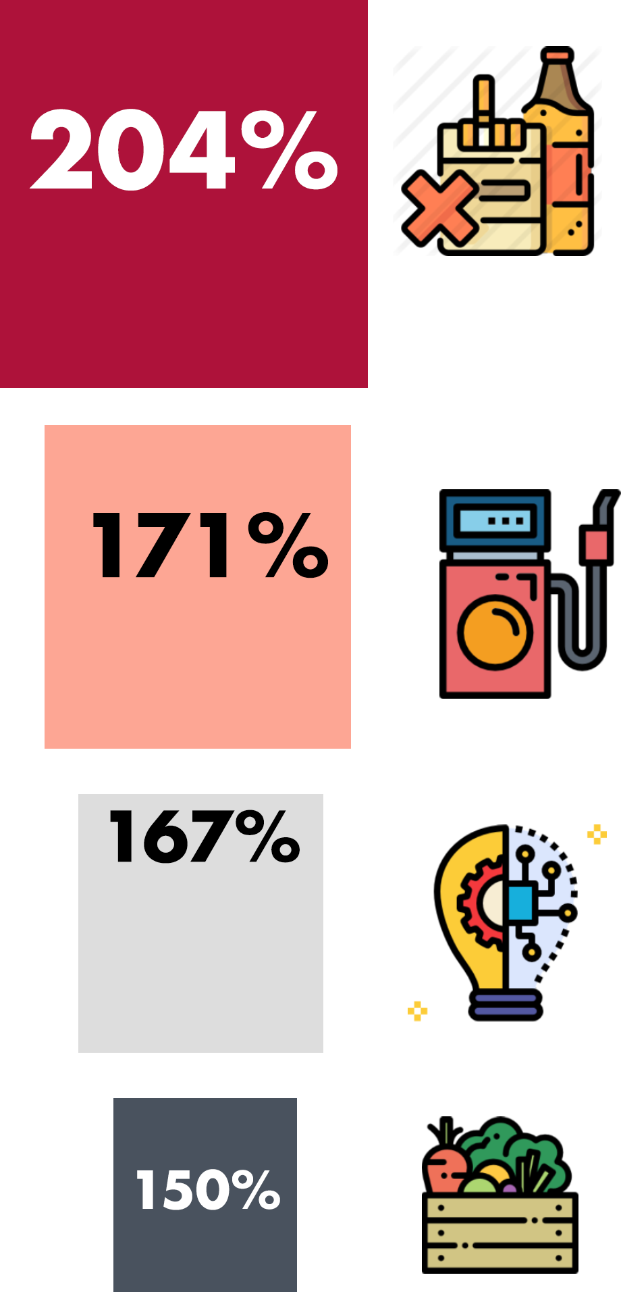
Consumer Price Index

Slide 12
Perspectives on the future

Slide 13
Evolution per sector
Top Increase :
Utilities : 50%
Agriculture :17%
Construction : 8%
Top Decrease :
Forestry, fishing, mining : -40%
Information, culture : -16%
Trade : -8%.

Slide 14
Perspectives on the future
2016
2020
45.70
388.6 K
47.40
377 K
Median Age
Active Population
Notes:
Make it easier : ActivePop (2016 -> 2020) -> decreasing.
Median Age (2016 -> 2020) -> getting older

Slide 15
Recommandations

Slide 16
Make those questions great

